Slide 1

Geographical Skills
The use of Maps and Atlases

Slide 2
1. Identify and interpret a variety of topographic and thematic maps (physical, political, and social maps, synoptic charts and climate maps) at different scales (local, national and global)
Syllabus Point.

Slide 3
The earliest known maps are of the stars, not the earth. Dots dating to 14,500 BC found on the walls of the Lascaux caves map out part of the night sky, including the three bright stars.

Slide 4
Maps
Maps provide us with information about places and help to identify patterns and changes in the landscape.
A map is a graphic representation of a place which has been drawn to scale.
The amount of detail will depend on the scale and the type of information contained within the map will depend on the purpose.

Slide 5
Types of Maps

Slide 6
Activity: Give One, Get One

Slide 7
Definitions

Slide 8
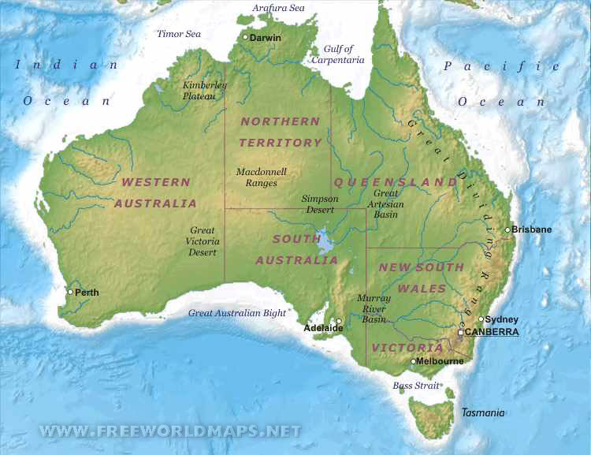

Slide 9
Physical Maps
Show selected features of the physical environment (mountains, plains, rivers, lakes, seas and oceans).
Colour shading is often used to show height above sea level.

Slide 10
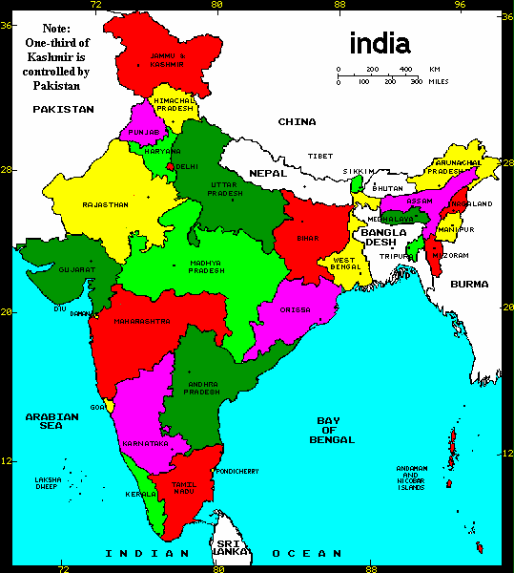

Slide 11
Political Maps
Show different political units (countries and states)
Political boundaries
Capital cities

Slide 12
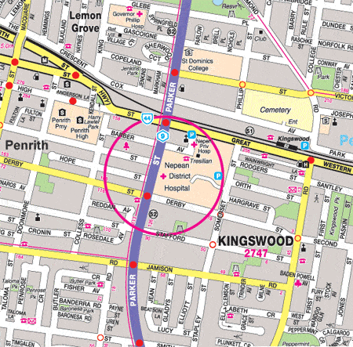

Slide 13
Street Maps
Are large-scale maps showing the location and names of streets
May also show the location of significant features of the human environment and important landmarks

Slide 14
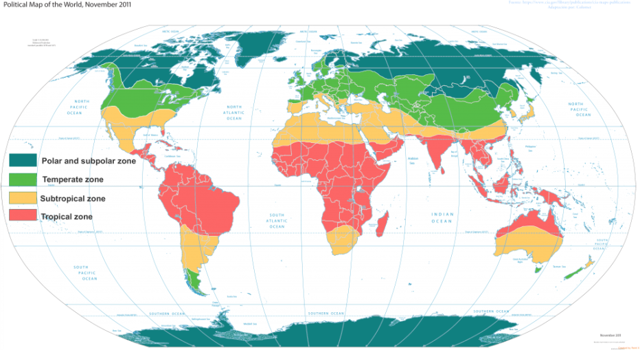

Slide 15
Thematic Maps
Illustrate a particular theme or issue
May be used to show the distribution of something (climate, vegetation types, average rainfall, population etc)
Can be compared to identify links/associations between different sets of geographical information

Slide 16
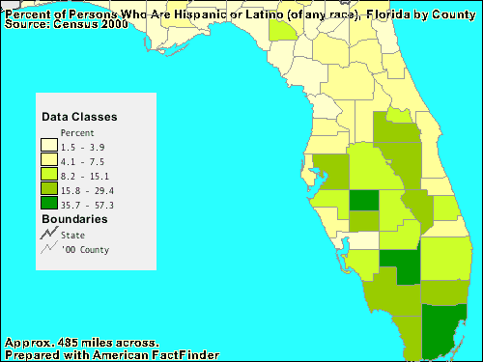

Slide 17
Choropleth Maps
Often used to show thematic material
They use different shades of one colour to show a pattern
The darker shades show the highest values and the lightest shades show the lowest values

Slide 18
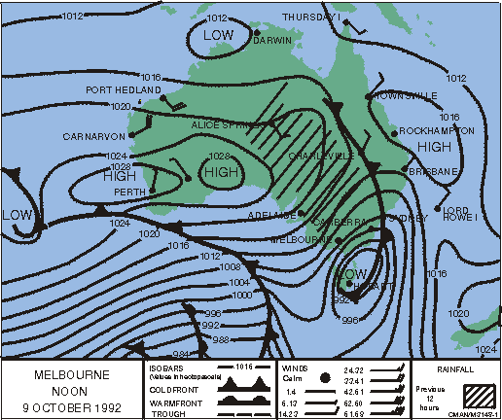

Slide 19
Weather Maps
Also known as synoptic charts
Seen daily in the news, they show weather conditions over part of the earth’s surface at a particular time
They show air pressure, wind direction and strength and rainfall received in the previous 24 hours
Weather maps allow us to make predictions about the weather over the next few days

Slide 20
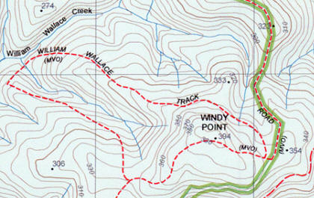

Slide 21
Topographic Maps
A detailed, large scale map of part of the earth’s surface
Shows selected features of the physical and human environment
Physical: Height, relief and slope of the land, drainage patterns and vegetation.
Built features: settlements, transport links.
Being able to read topographic maps allows us to locate features of physical and human environments, describe distributions and patterns, and identify relationships between features.

